Slide 1
Segmented Regression (piecewise regression)
Regression analysis where the independent variable(s) are partitioned into intervals and separate line segments are fit to each interval.
Strength
Identification of break points has been used to identify thresholds (Betts et al. 2007- logistic segmented regression).
Break point(s) can be tested
Weakness
Simpson’s paradox – trends appearing in groups of data disappears or reverse when groups are combined.
Some subjectivity when picking where to place break points.

Slide 2
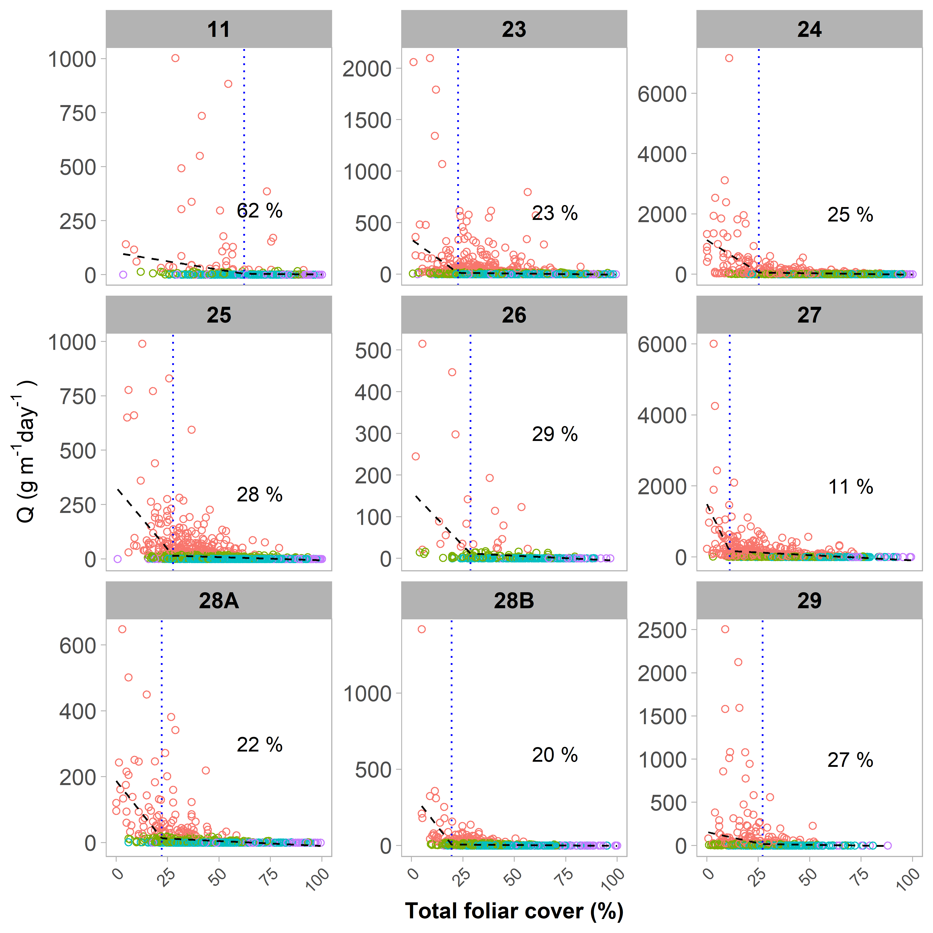

Slide 3
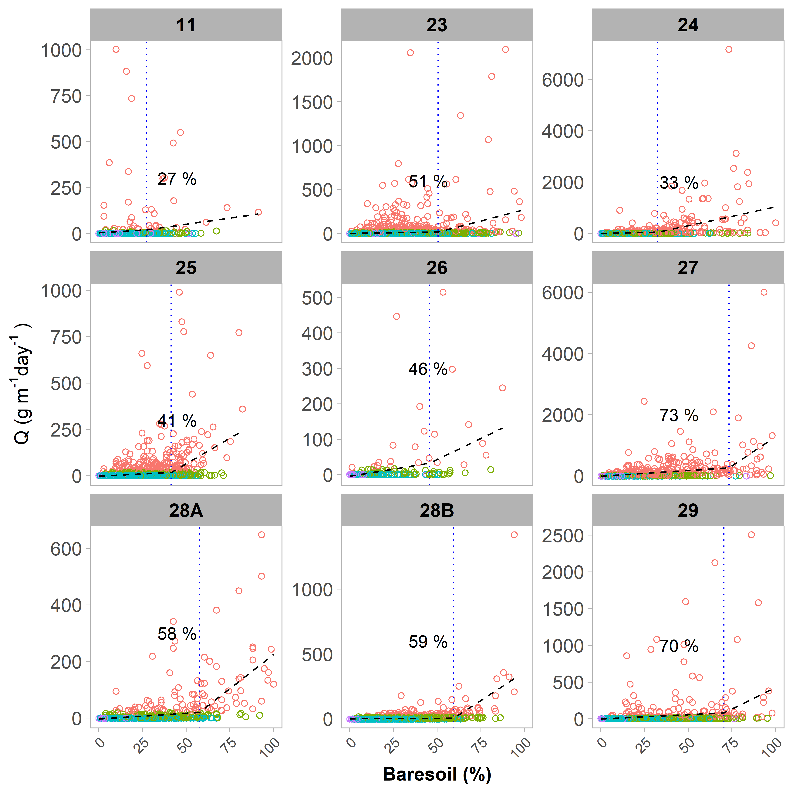

Slide 4
Multi-model inference
Statistical model selection framework where multiple competing models representing biological hypotheses are ranked by how well each fit data using relative likelihoods.
Strengths
“strong inference” through testing many hypotheses.
Model averaging can deal with uncertainty in model estimates
Weaknesses
Difficult to interpret and to implement results in adaptive management
Need to carefully develop candidate set of models which can take up a lot of time and can require a lot of data.

Slide 5
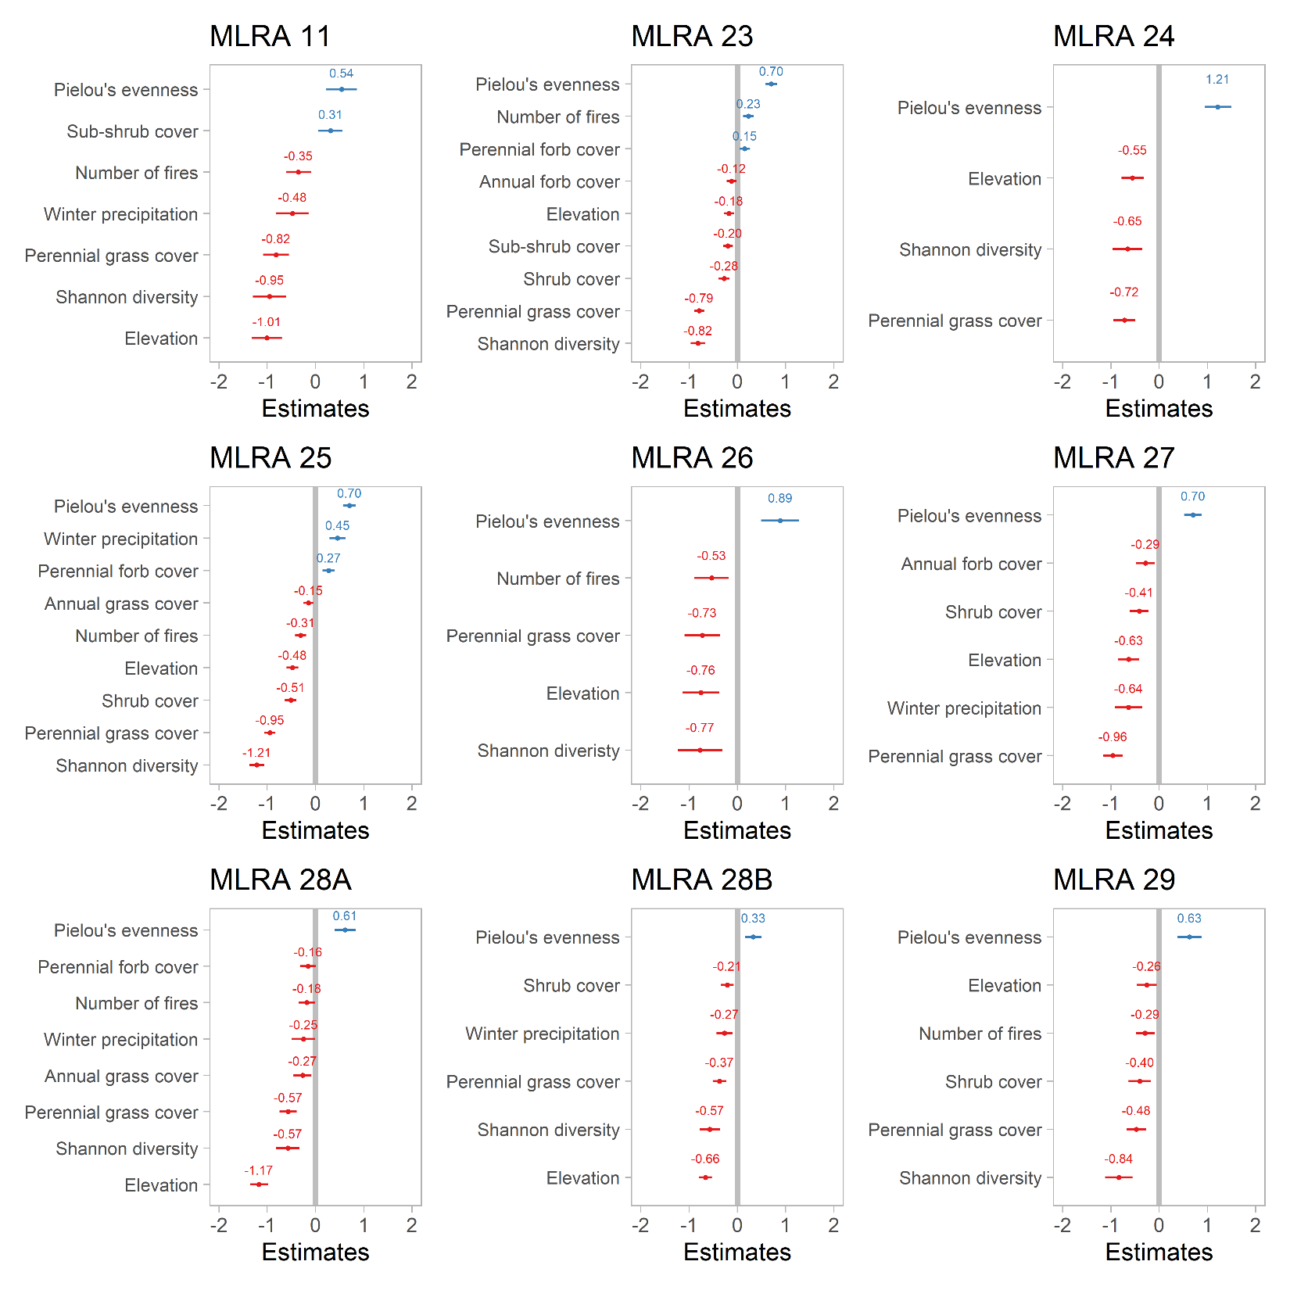
Results of top candidate model for each MLRA

Slide 6
“Classical” statistical methods
Linear models, generalized linear models, linear mixed models…etc.
Strengths
Large body of resources of how to use and apply methods
Have been used extensively in ecology.
Weaknesses
Boring (my own biased opinion!)
Can difficult to tie measures of and effects on variability of response variable to a benchmark/threshold.
Assumptions must be met or at least not “delicately” violated.
Classification and Regression Trees (CART)
Strengths
Easy to explain results
Weaknesses
Can be inadequate for predicting continuous values

Slide 7
Order of magnitude

Slide 8
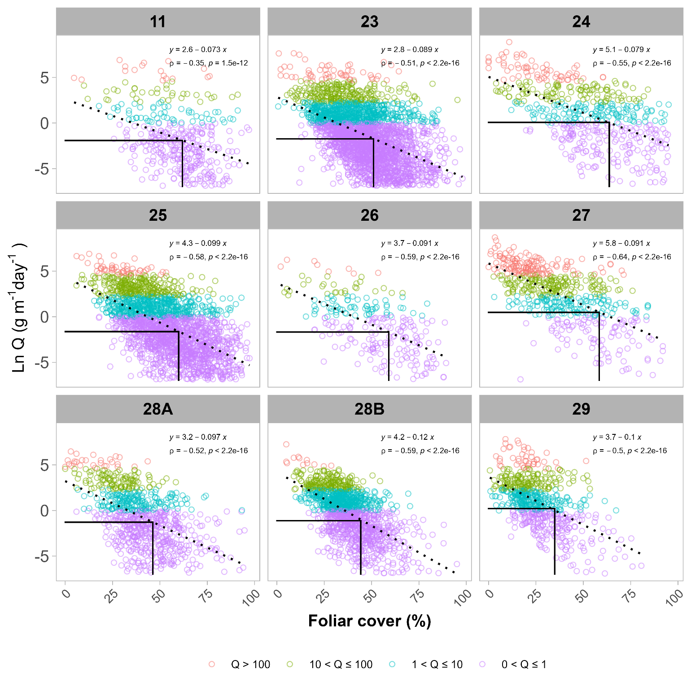
Figure 8. Plot of natural log-transformed modelled horizontal sediment flux (Q) and foliar cover categorized by increasing magnitude of sediment flux. Points across MLRAs represent AIM monitoring plots where data were collected. The vertical lines denote mean foliar cover percent for each flux magnitude. Note plots with modelled Q = 0 have been removed from analysis due to undefined values when log transforming data.
3.4 Ground cover thresholds

Slide 9
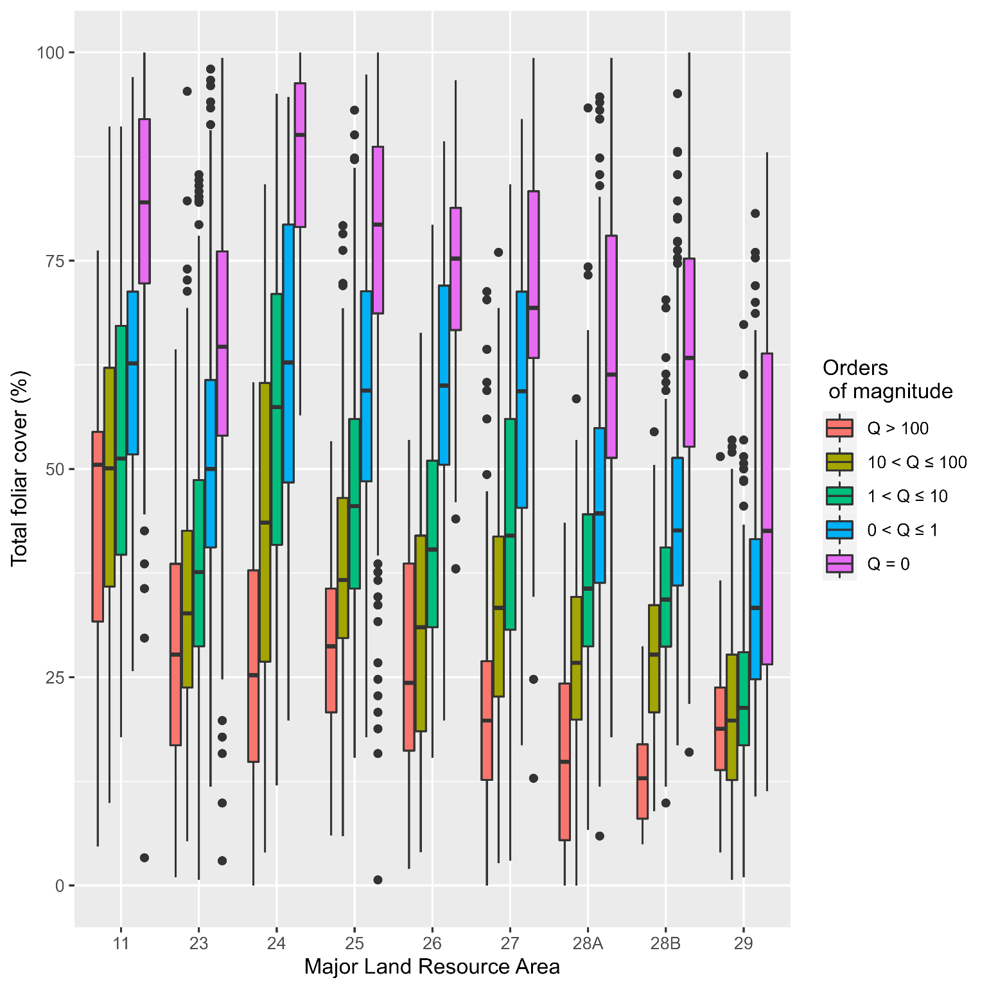
Analysis by order of magnitude in Q
Supplement 2. Distribution of foliar cover for MLRA by order of magnitude in Q

Slide 10
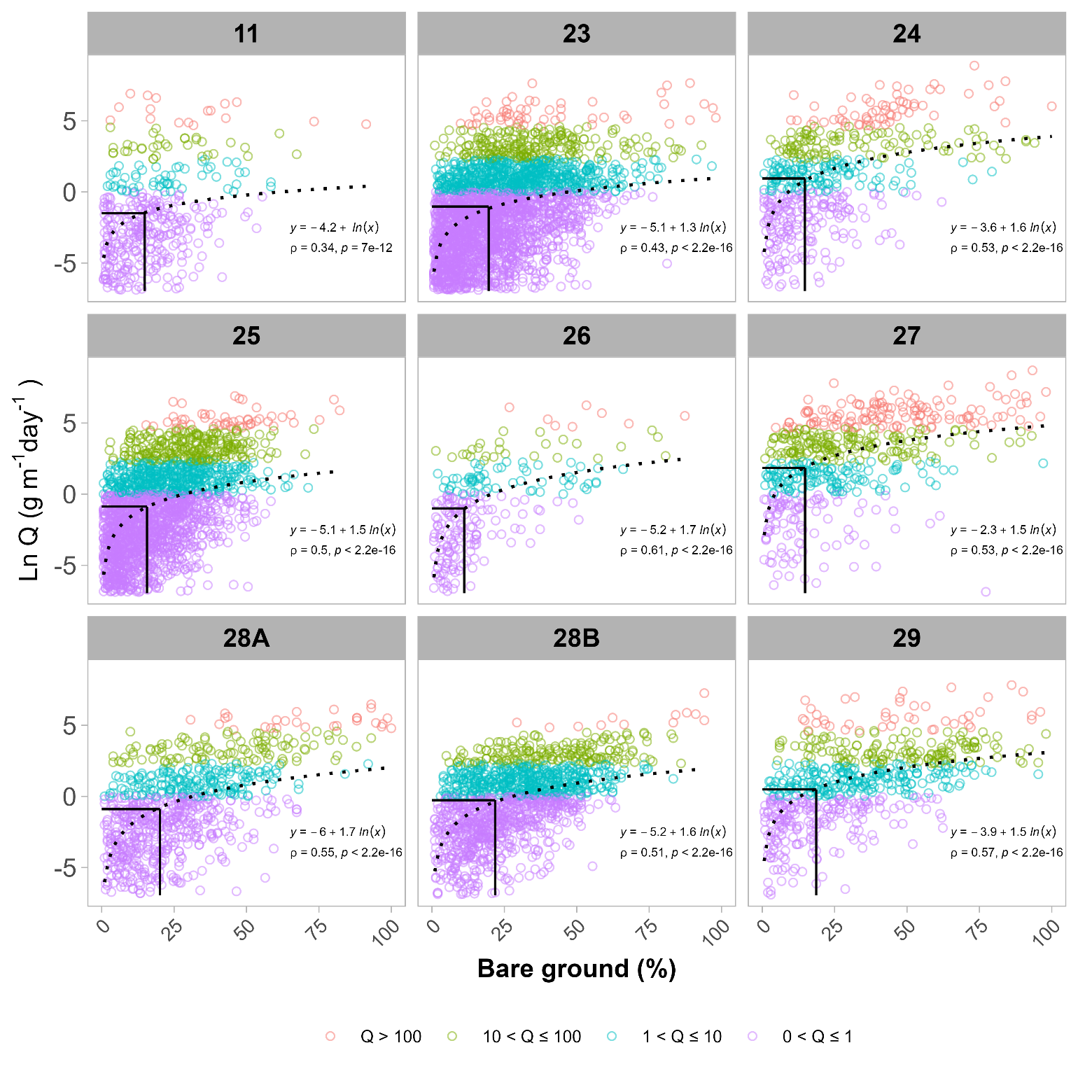
Figure 9. Comparison of the relationship between natural log-transformed Q and monitoring plot percent bare ground between Major Land Resources Areas comprising the Great Basin in the western United States. Vertical lines represent the mean bare ground percentage for each magnitude of horizontal flux. Note plots with modelled Q = 0 have been removed from analysis due to undefined values when log transforming data.
3.4 Ground cover thresholds

Slide 11
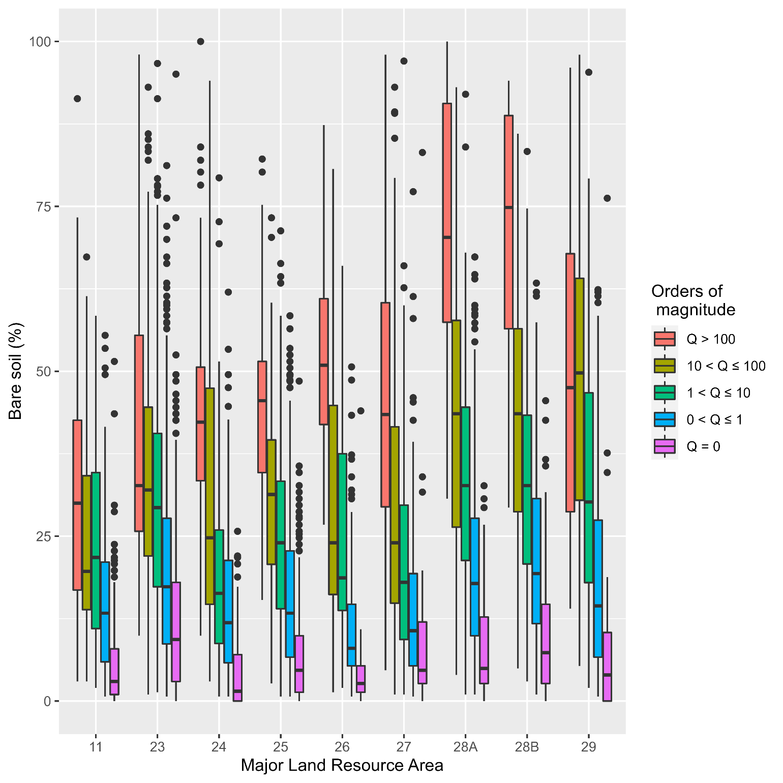
Supplement 2. Distribution of bare soil for MLRA by order of magnitude in Q

Slide 12
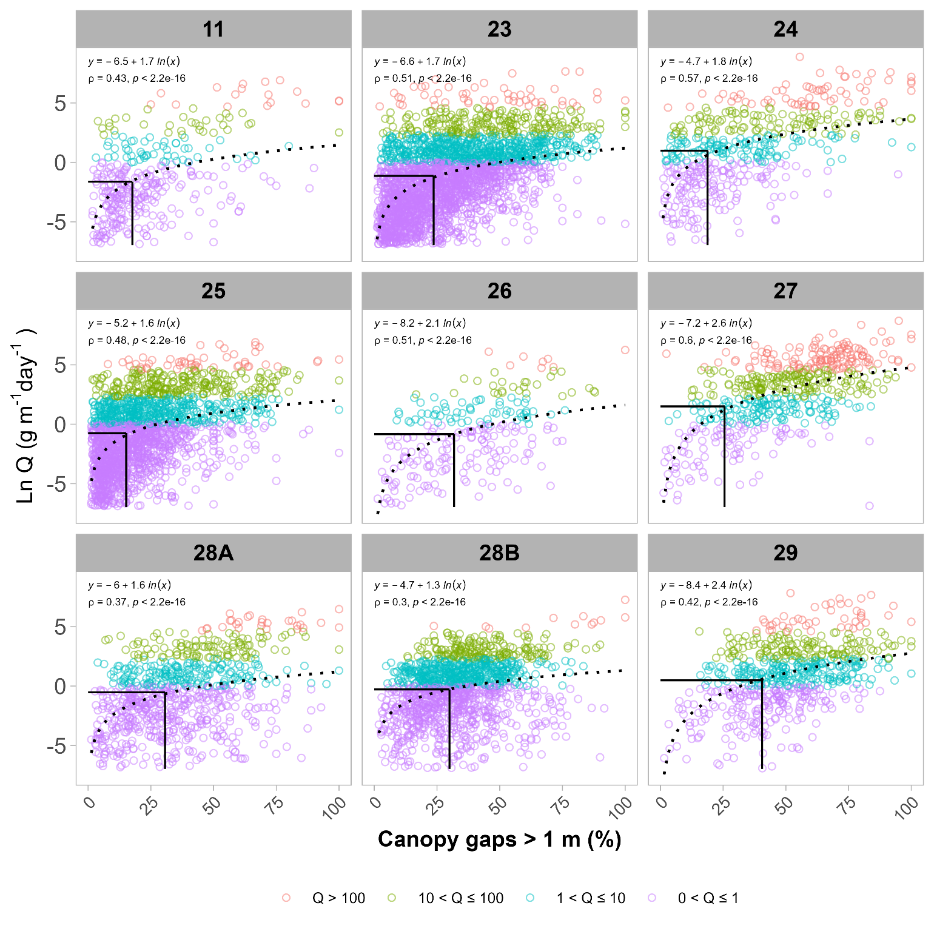
Figure 10. Comparison of the relationship between natural log-transformed Q, category of flux, and percent unvegetated gaps > 1m occurring in monitoring plots across Major Land Resources Areas comprising the Great Basin in the western United States. Vertical lines represent the mean percentage of unvegetated gaps larger than a meter for each magnitude of horizontal sediment flux. Note plots with modelled Q = 0 have been removed from analysis due to undefined values when log transforming data.
3.4 Ground cover thresholds

Slide 13
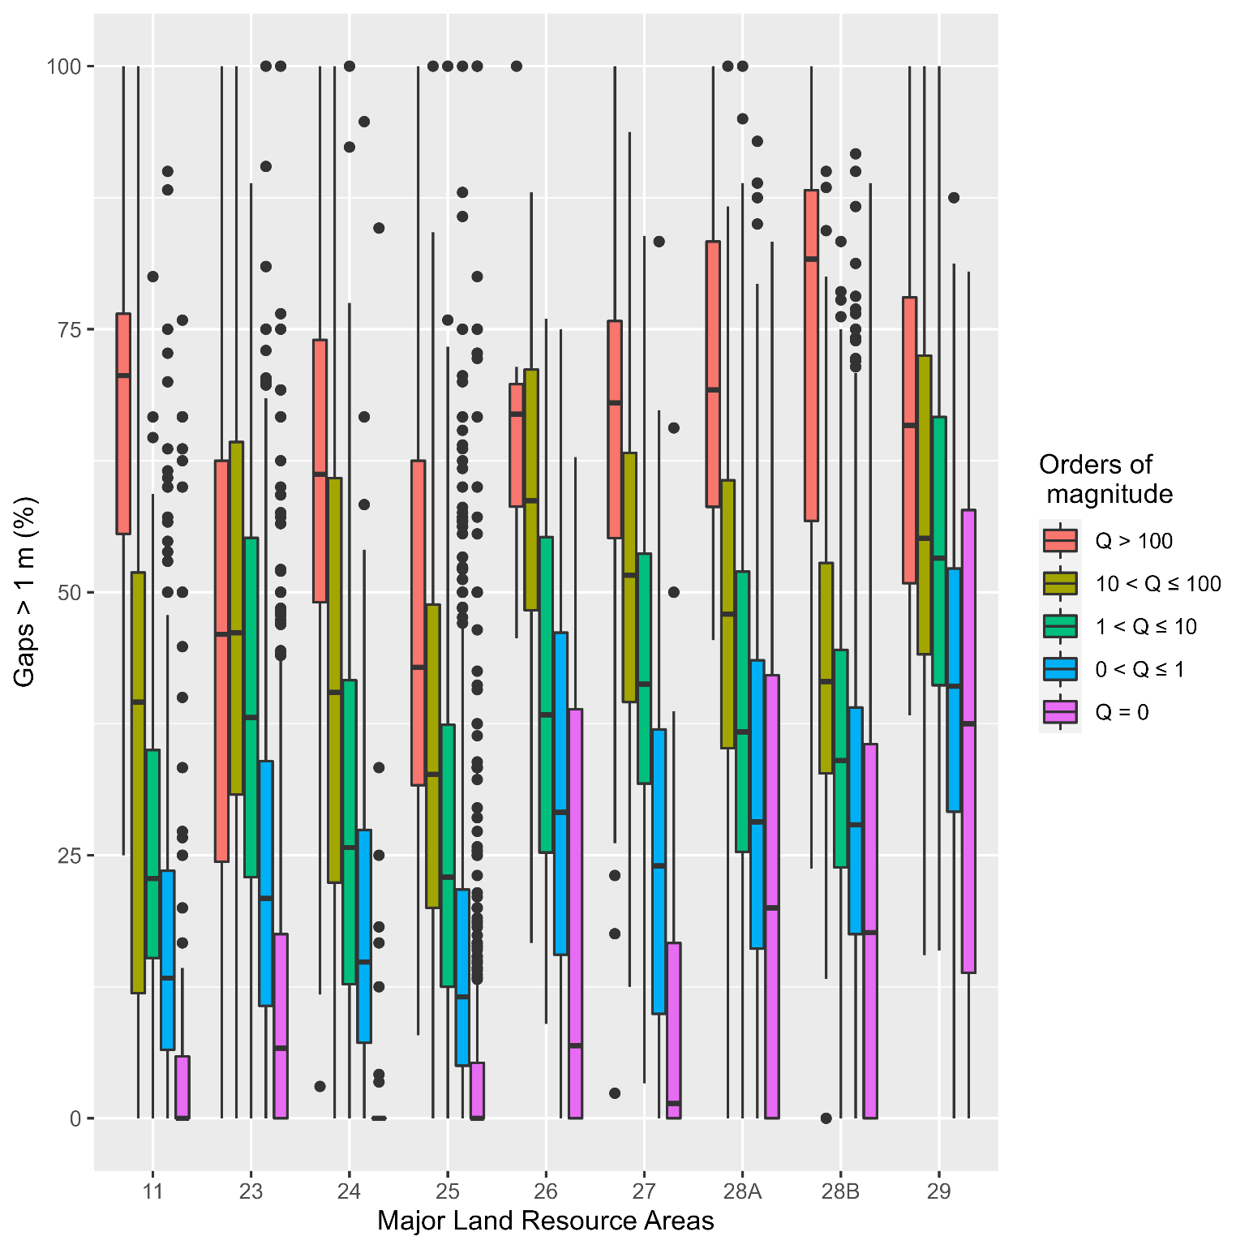
Supplement 2. Distribution of canopy gaps greater than 1 m for MLRAs by order of magnitude in Q

Slide 14
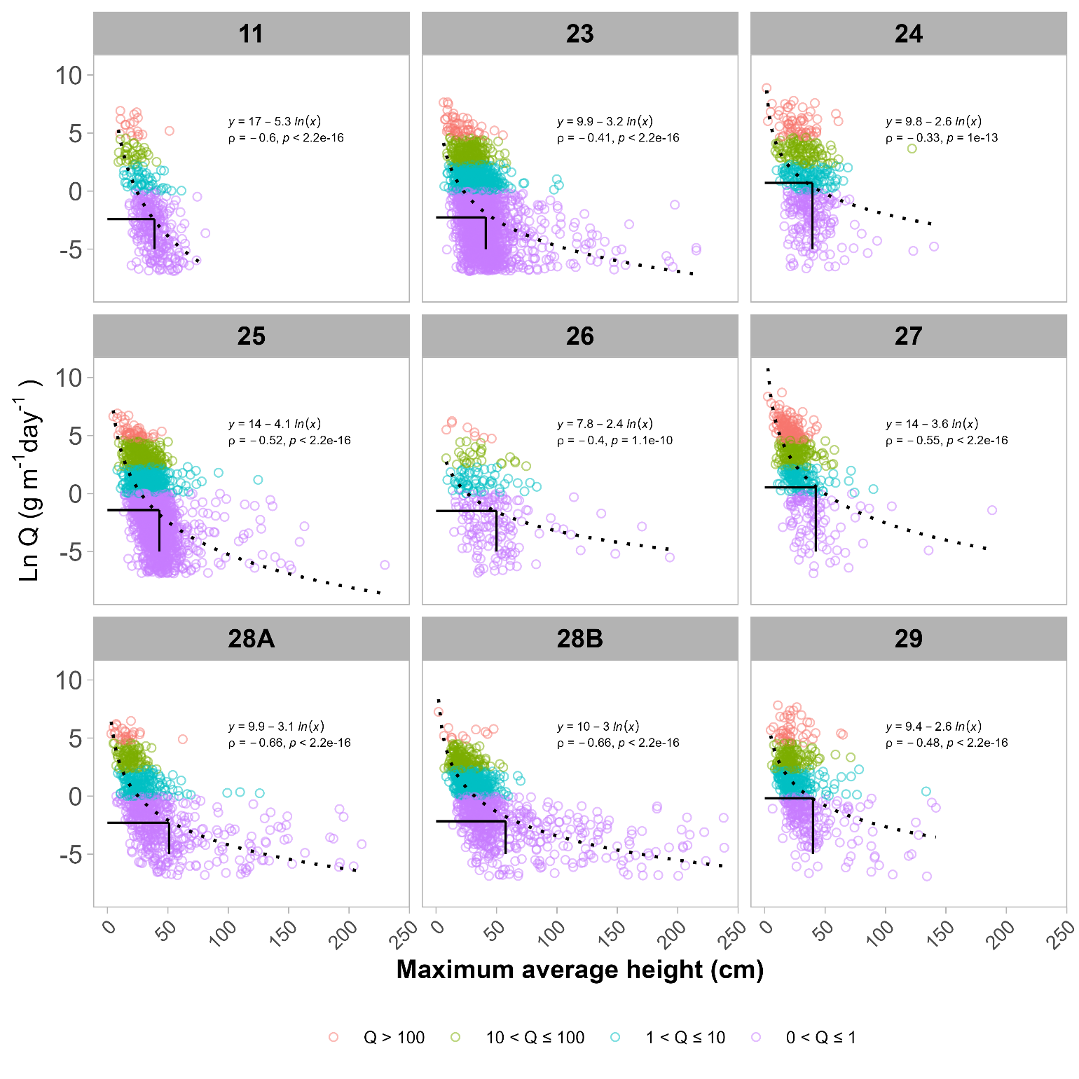

Slide 15
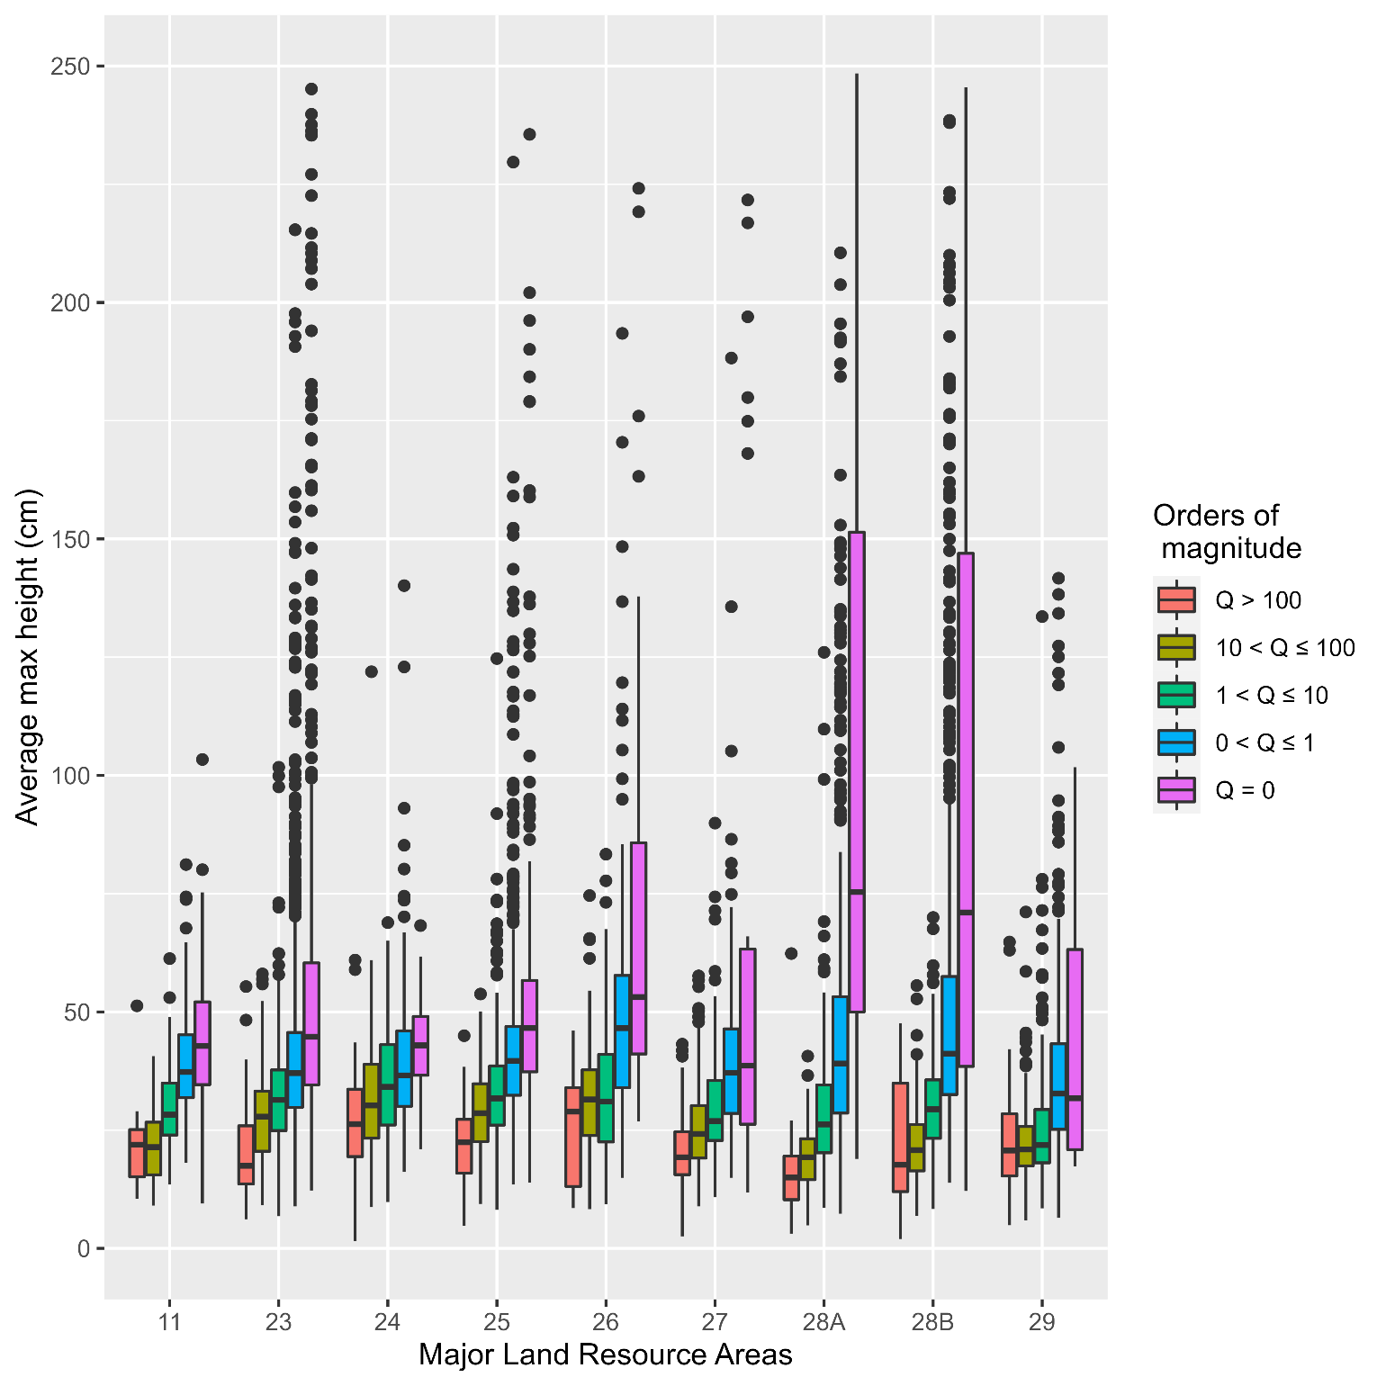
Supplement 2. Distribution of average maximum height for MLRA by order of magnitude in Q

